Slide 1
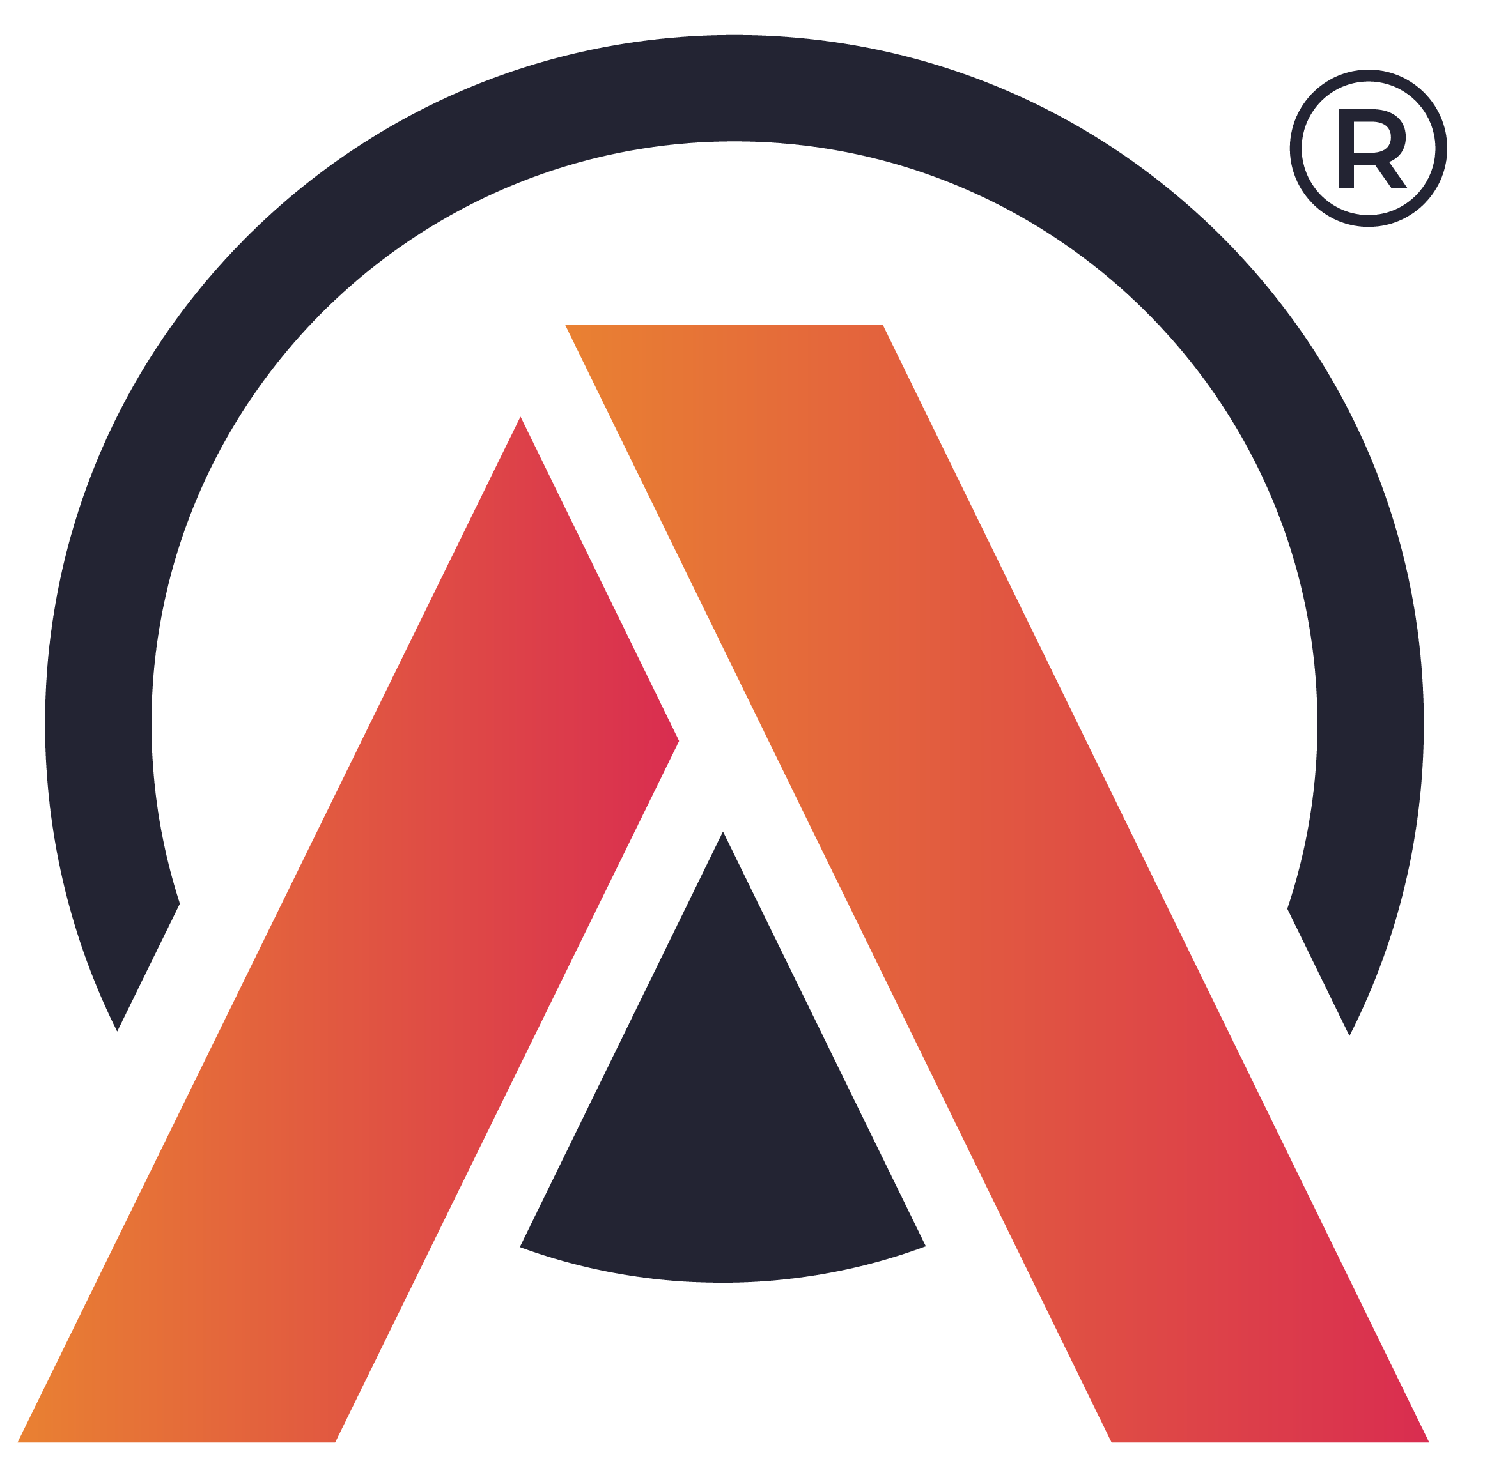
ATLIQ MART
SUPPLY CHAIN ANALYSIS

Slide 2
Content
About Atliq Mart
Problem Statement
Supply Chain Terminology
Dashboard
Inferences

Slide 3

About Atliq Mart
(This is a data analytics challenge by Code Basics.)
AtliQ Mart is a growing FMCG manufacturer (imaginary) headquartered in Gujarat, India.
It is currently operational in three cities Surat, Ahmedabad, and Vadodara.
They want to expand to other metro/tier 1 cities in the next 2 years.

Slide 4

Problem Statement
AtliQ Mart is currently facing a problem where a few key customers did not extend the annual contract due to service issues.
It is speculated that some of the essential products were either not delivered on time or not delivered in full over a continued period, which could have resulted in bad customer service.

Slide 5

Supply Chain Terminology - I
On Time % - Percentage of orders delivered before the promised delivery date.
In Full % - Percentage of orders delivered in desired quantity.
On Time In Full % - Percentage of orders that were on time and delivered in full quantity.
Order – Unique request of products placed by a customer on a given date.
Total Orders – Number of orders placed by customers in a definite period.

Slide 6
Supply Chain Terminology - II
Order Line – Within an order, a customer can request multiple items. Each of these is called an order line.
Line Fill Rate – Percentage of lines fulfilled out of the total lines ordered.
Volume Fill Rate – Percentage of quantities delivered compared to the total requested.
Total Order Lines – Number of order lines combined from all orders.

Slide 7
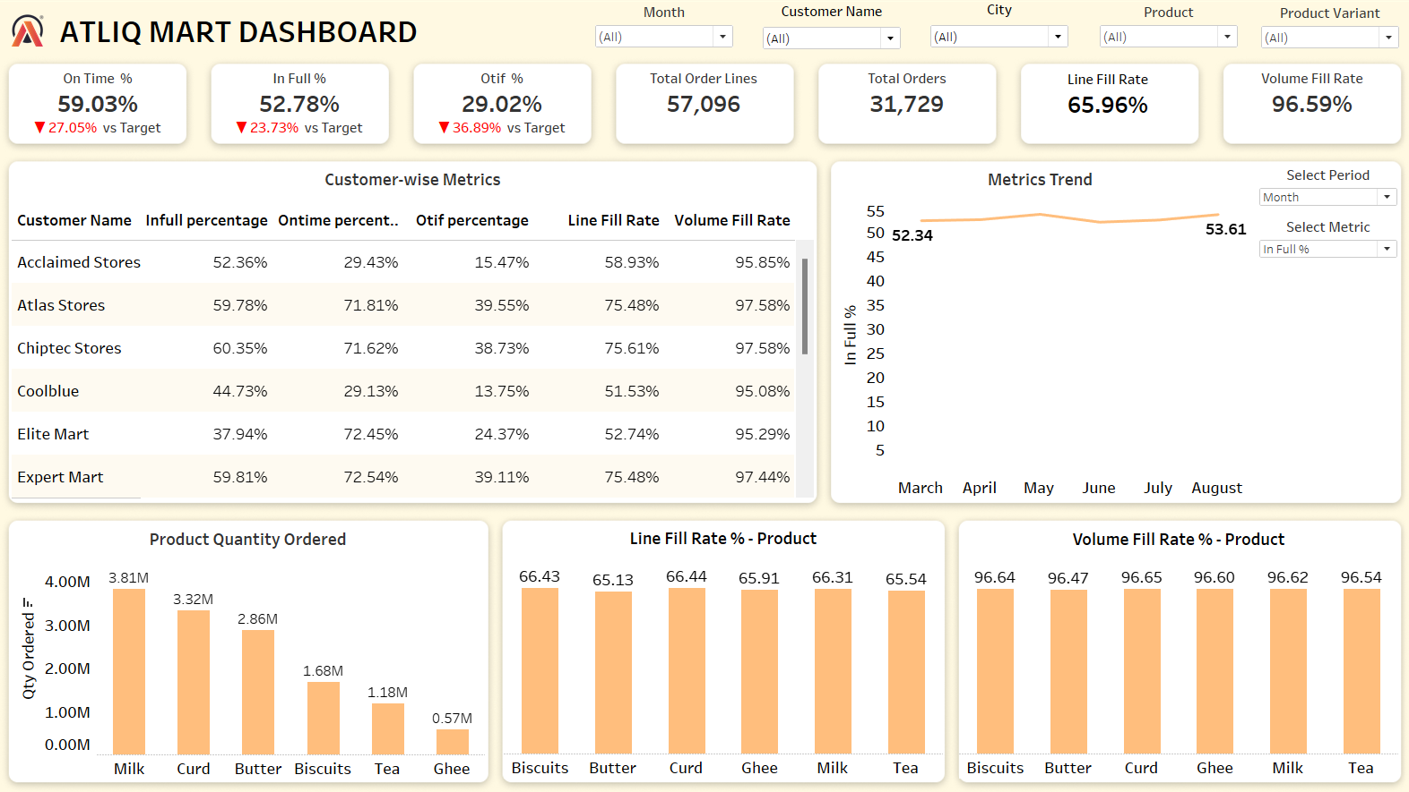
Dashboard

Slide 8
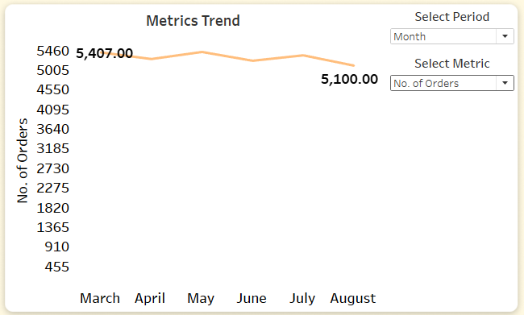
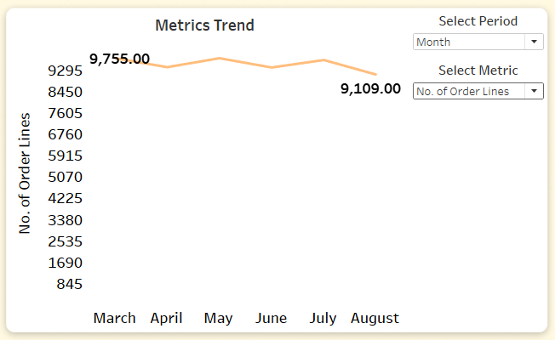
Inferences - I
Overall:
The no. of orders has declined in the period March-August by 300.
No. of Order Lines has been reduced by 600.
The decline can be seen in all product categories and from almost all the customers.

Slide 9
Inferences - II
The actual percentages for OT, IF, and OTIF were considerably lower than the average target values, with OTIF % showing the greatest deviation.
While the VOFR stands at nearly 96% for all products, indicating that the required quantities were largely supplied, the LIFR reveals that only 66% of order lines were actually fulfilled. This suggests that, on average, a small quantity was missing in 34% of the order lines.

Slide 10
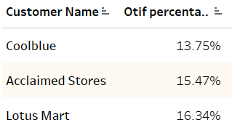
Inferences - III
For the customers - Acclaimed Stores, Lotus Mart, and Chiptec Stores, the OTIF % are the lowest (~14.5%). For the other companies, it’s between 25-40.
Not even 50% of their orders are fulfilled on time.
There’s a need to increase these percentages in the future to keep up with the customer satisfaction, requirements and prevent high churn rate for the end customers due to the shortage.

Slide 11

Inferences - IV
The most ordered items are: Milk and Curd which are highly perishable. The lower OTIF % for these two products can be due to the following reasons:
Inconsistent production of milk due to poor cattle health and seasonal variations.
Spoilage and contamination due to bacterial growth because of compromised cold storage.

